Slide 1
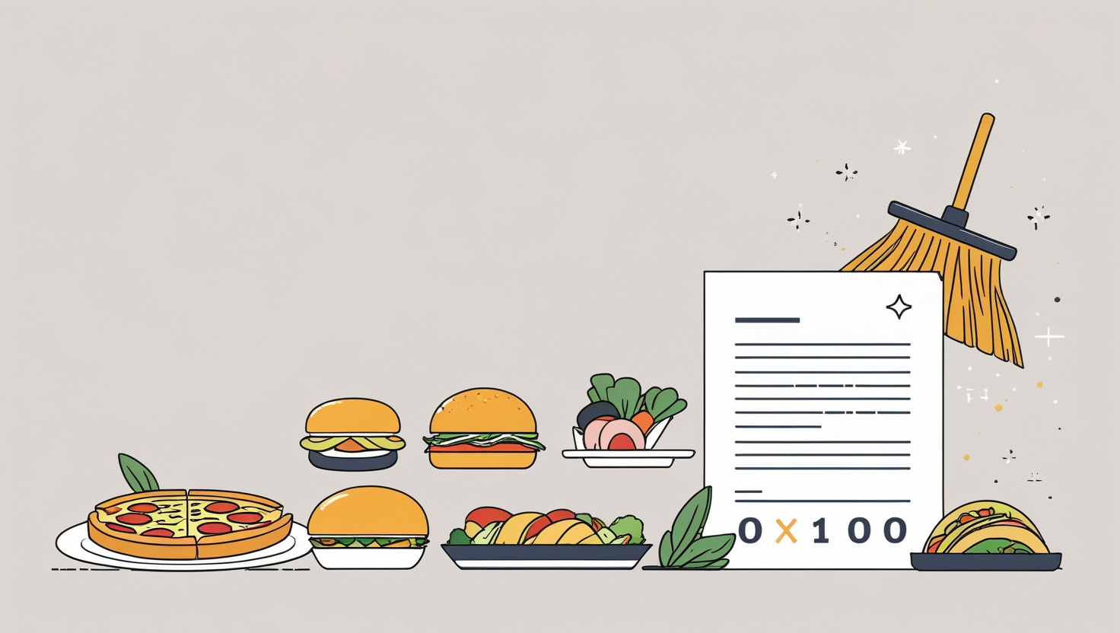
Food Coded
Cleaning Project
By: Liliana A. Diaz S.

Slide 2


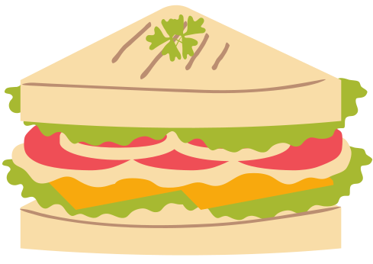
About Dataset
The Food Coded dataset contains responses from university students about their eating habits, preferences, and the factors that influence their food choices.
It includes categorical data, free text responses, missing values, and numerical encodings for almost all variables.
Original Source
https://www.kaggle.com/datasets/borapajo/food-choices?select=food_coded.csv

Slide 3





Identified data issues
1.Missing values in several columns
2. Duplicate columns
3. Incorrect data types, e.g., numeric values stored as text
4. Text in numeric columns, causing format issues
5. Inconsistent text formatting, with mixed lowercase and uppercase

Slide 4
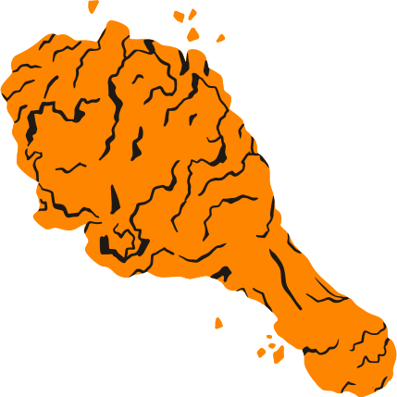
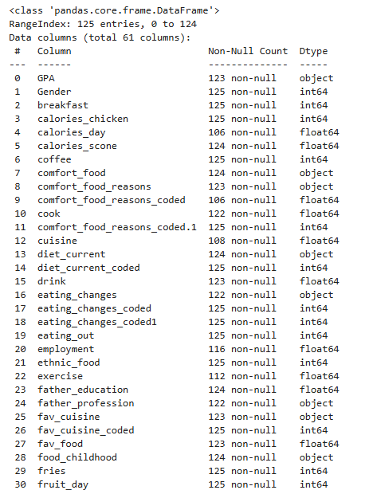
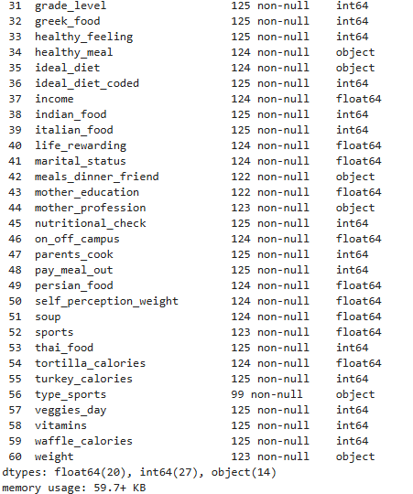

1. Introduction
import pandas as pd
import numpy as np
df = pd.read_csv(r'E:/Descargas/food_coded.csv')
df.shape
df.info()

Slide 5
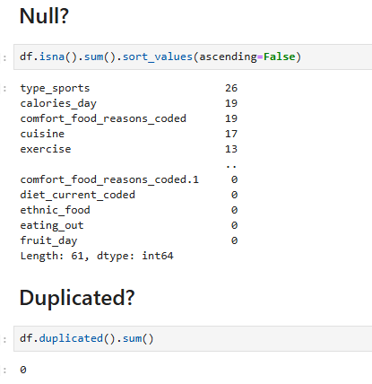

2. Introduction
Null?
Duplicated?
df.isna().sum().sort_values(ascending=False)
df.duplicated().sum()

Slide 6
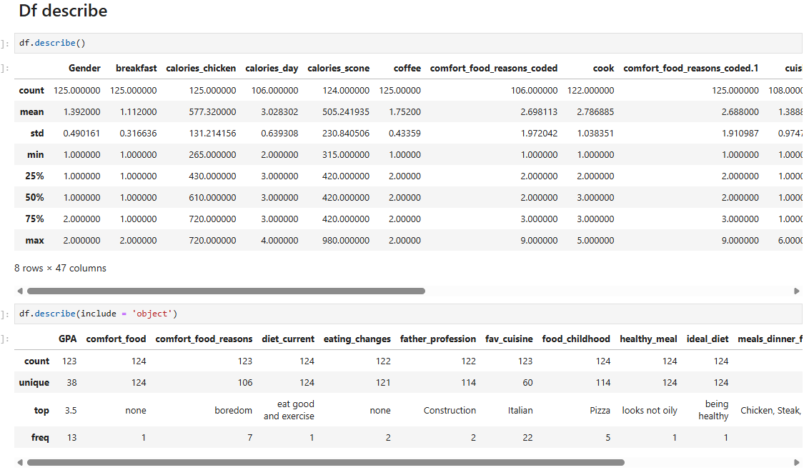

3. Introduction
Df describe
df.describe()
df.describe(include = ‘object’)

Slide 7
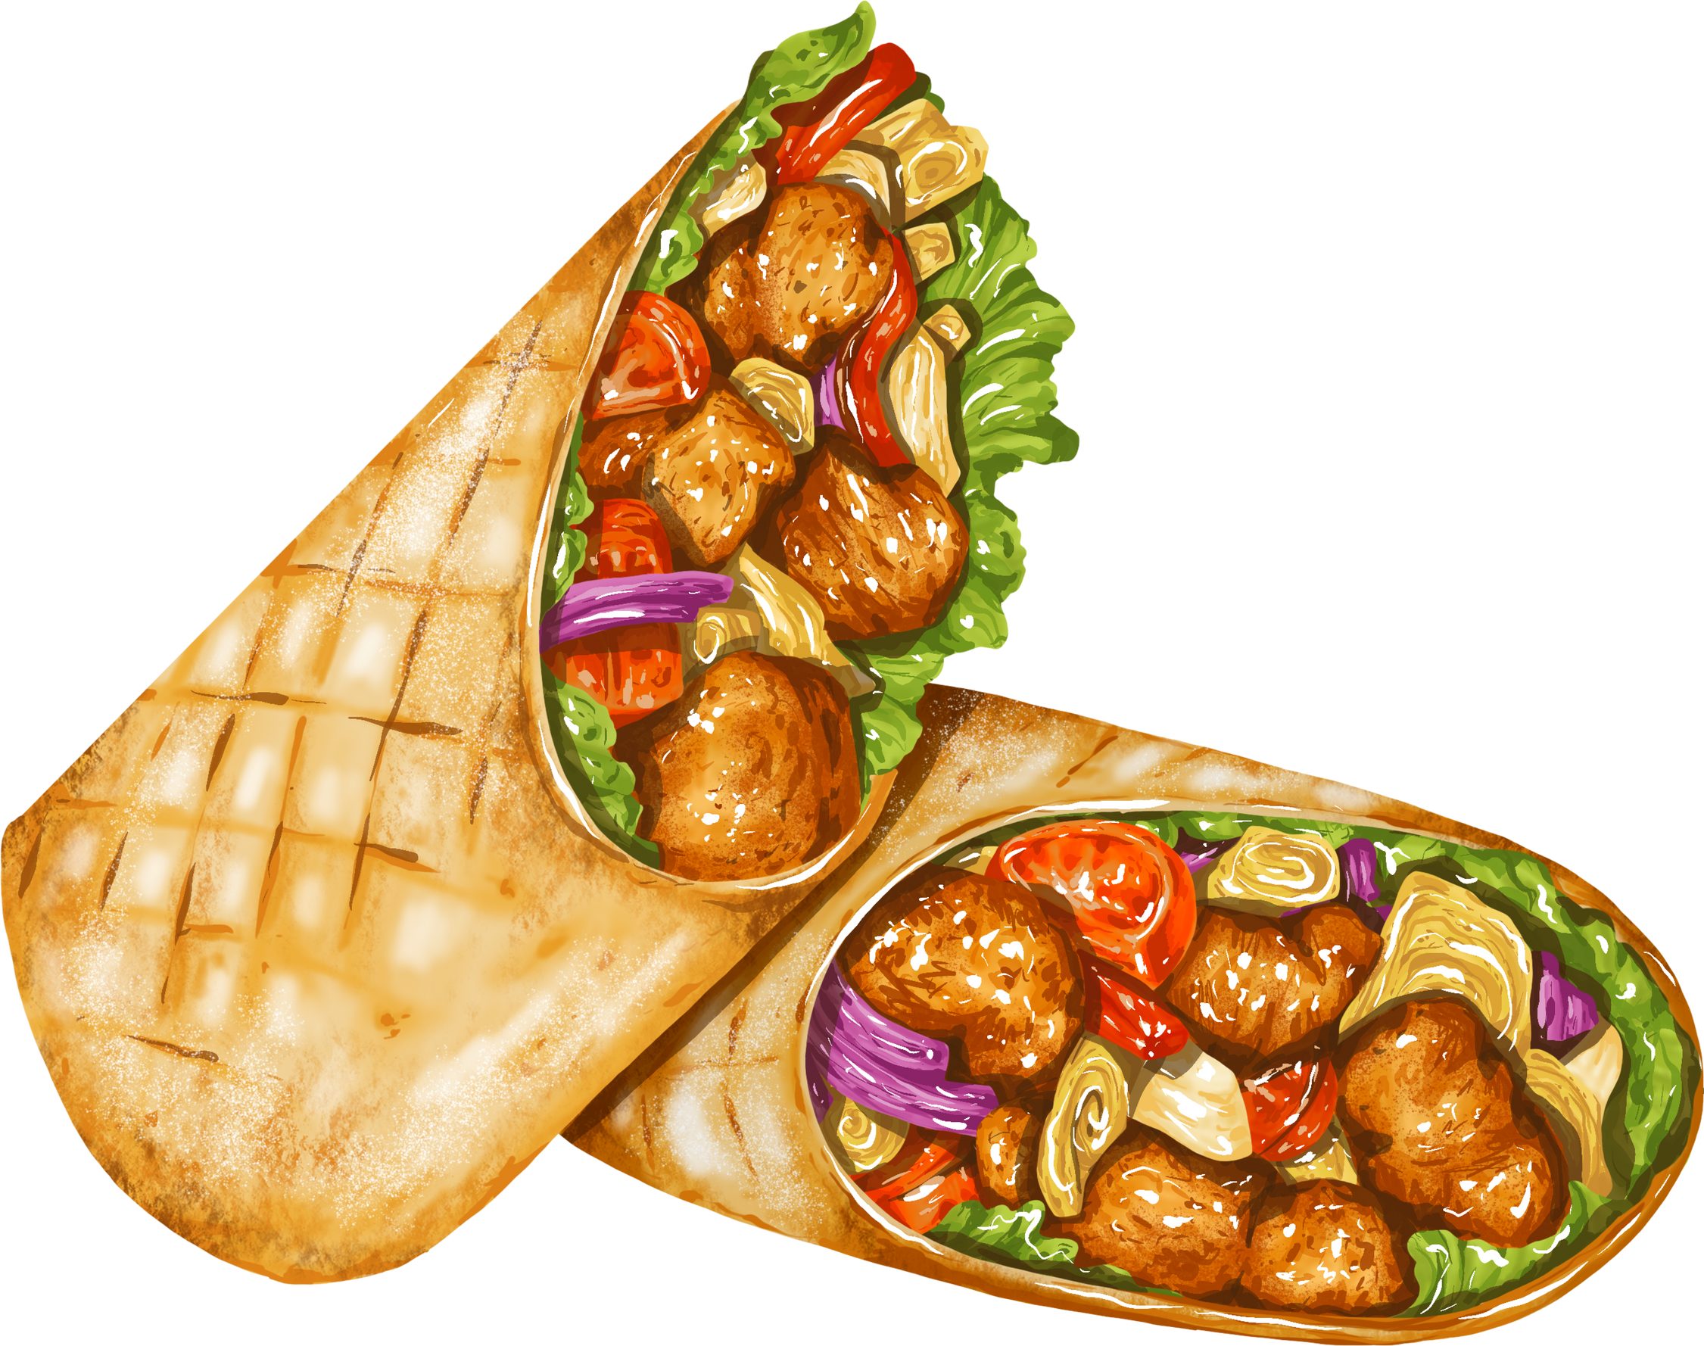
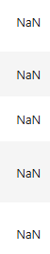
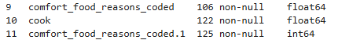
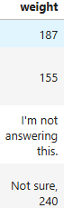
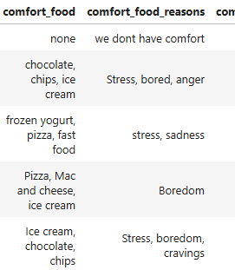

Before Cleaning
I #1
I #2
I #3
I #4
I #5

Slide 8


1. Cleaning Process
Replace text with NaN in the 'weight' column
df['weight'].replace(["I'm not answering this"], np.nan, inplace=True)

Slide 9

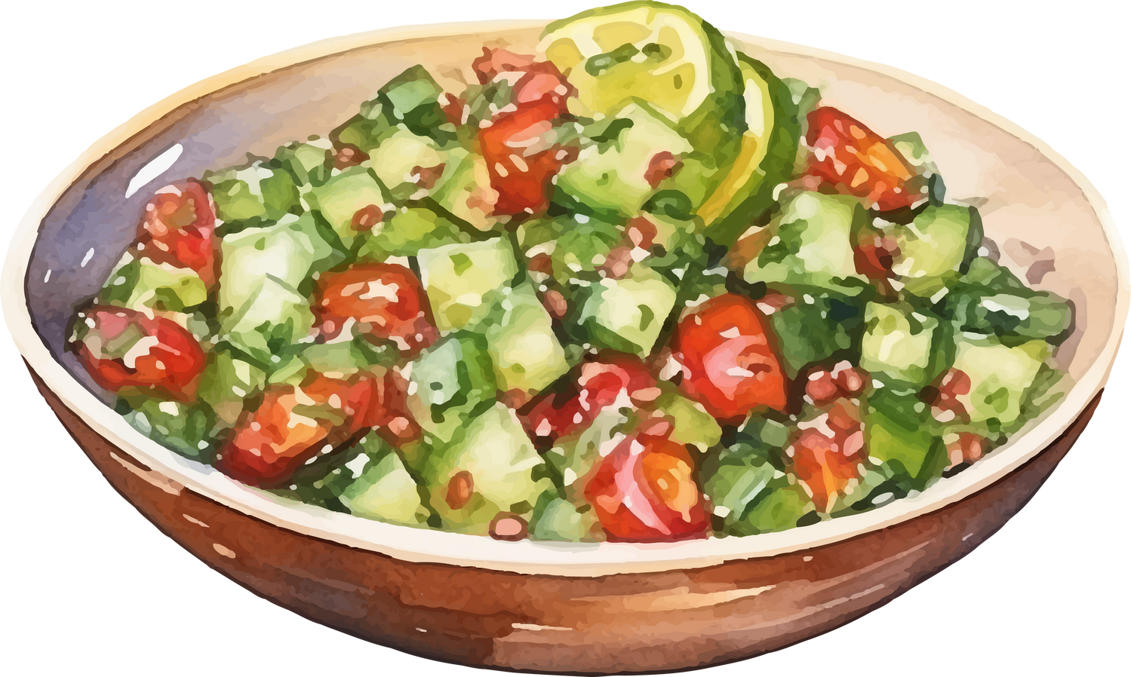
2. Cleaning Process
Extract only the numeric values from the 'weight' and 'GPA' columns and create new columns from them
df['weight_clean'] = df['weight'].str.extract(r'(\d+\.?\d*)')
df['GPA_clean'] = df['GPA'].str.extract(r'(\d+\.?\d*)')

Slide 10

3. Cleaning Process
Convert 'GPA_clean' and 'weight_clean' columns to float type
df[['GPA_clean', 'weight_clean']] = df[['GPA_clean', 'weight_clean']].astype(float)

Slide 11
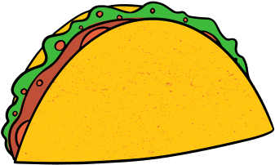
4. Cleaning Process
Move 'GPA_clean' column to the front of the DataFrame
columna = 'GPA_clean'
resto = [col for col in df.columns if col != columna]
df = df[[columna] + resto]

Slide 12

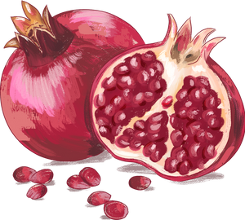
5. Cleaning Process
Drop unnecessary or redundant columns from the DataFrame
df.drop(columns=['comfort_food_reasons_coded', 'eating_changes_coded', 'GPA', 'weight'], inplace=True)

Slide 13


6. Cleaning Process
Rename cleaned columns to replace original names
df.rename(columns={
'GPA_clean': 'GPA',
'weight_clean': 'weight'}
, inplace=True)

Slide 14
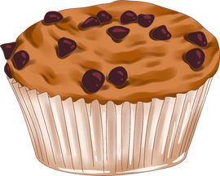
7. Cleaning Process
Select numeric columns and convert them to float type
columnas_numericas = df.select_dtypes(include=['int64', 'float64']).columns
df[columnas_numericas] = df[columnas_numericas].astype(float)

Slide 15
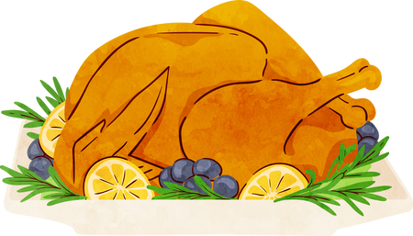

8. Cleaning Process
Convert all text columns to lowercase
columnas_texto = df.select_dtypes(include=['object']).columns
df[columnas_texto] = df[columnas_texto].apply(lambda col: col.str.lower())

Slide 16
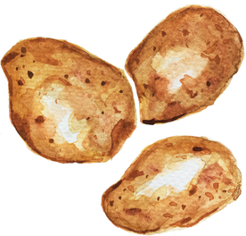

9. Cleaning Process
Fill missing values in all columns with the mode of each column
for col in df.columns:
moda = df[col].mode()
if not moda.empty: df[col].fillna(moda[0], inplace=True)

Slide 17

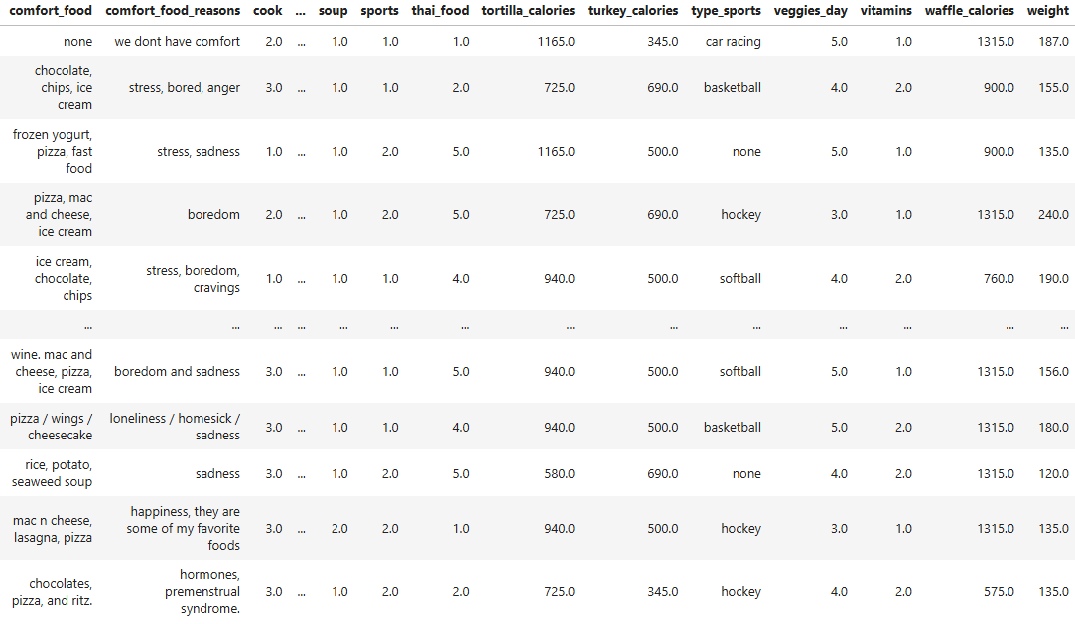
End
Check cleaned DataFrame and Save
df
df.to_csv(r'E:/Descargas/foodcoded_clean.csv', index=False)

Slide 18
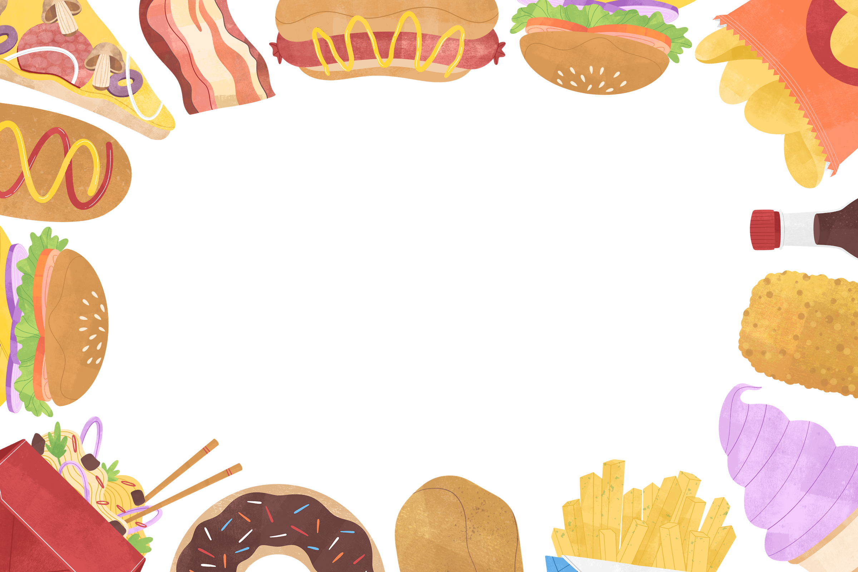
Thank you!

